Slide 1
Ghorowa Khana

Slide 2
Ghorowa Khana
Presentation By Sameen Wasif Hussain, Roll-19 Saklain Zaman, Roll-31 Chinmoy Chakraborty, Roll-55

Slide 3
Motivation
There are many people who are passionate about cooking. They cook from their own interest , main goal of our project is to make this passion economically useful and thus empower small entrepreneurs.

Slide 4
Motivation
Our project also enables people to have home-made healthy food at anytime and anywhere they want at a reasonable price.

Slide 5
Features
User dashboard
Chef dashboard
Food menu management
Order status

Slide 6
Features
Chefs’ kitchen
Rating and review
Payment
Social media linkup

Slide 7
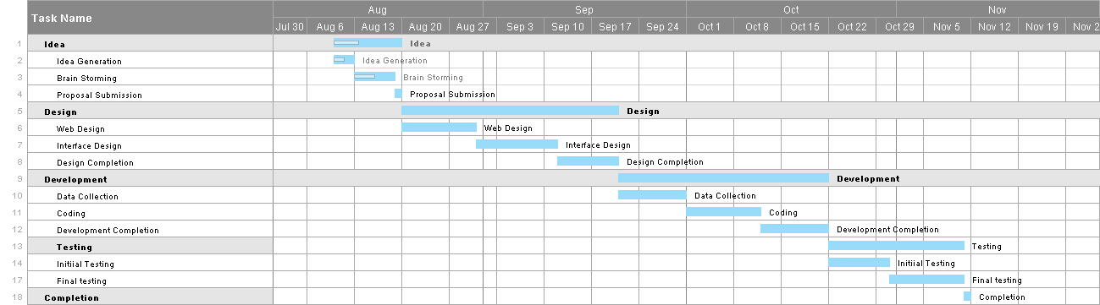
Tentative schedule

Slide 8
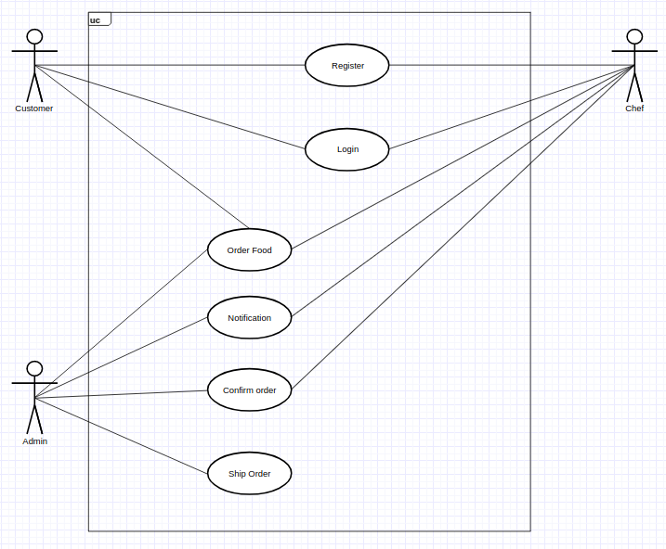
Use Case

Slide 9
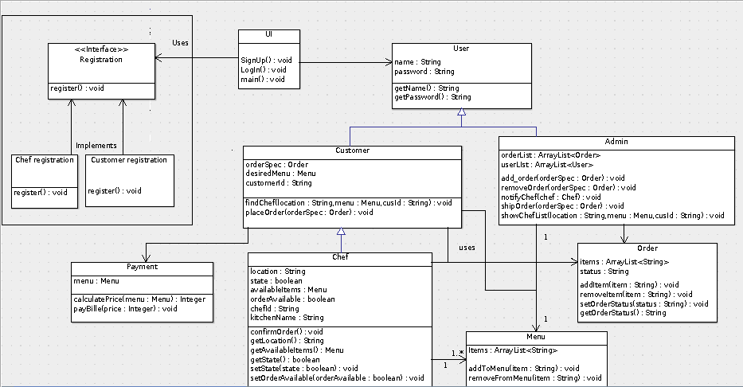
Class diagram

Slide 10
Design pattern
Strategy pattern
Observer pattern
Singleton pattern
Flyweight pattern
Chain of responsibility

Slide 11
Strategy pattern
We will use interface for registration process as it varies from chef to customer.

Slide 12
Observer pattern
When a customer will order some items then corresponding chef should be notified and the chef will confirm the order back again.

Slide 13
Singleton pattern
There will be only one storage unit which will be initiated at the very beginning and remain same after that.

Slide 14
Flyweight pattern
We will use a shared database , that means multiple user can access that at the same time.

Slide 15
Chain of responsibility pattern
In our project a single request can be handled by different objects.

Slide 16
UI Design

Slide 17
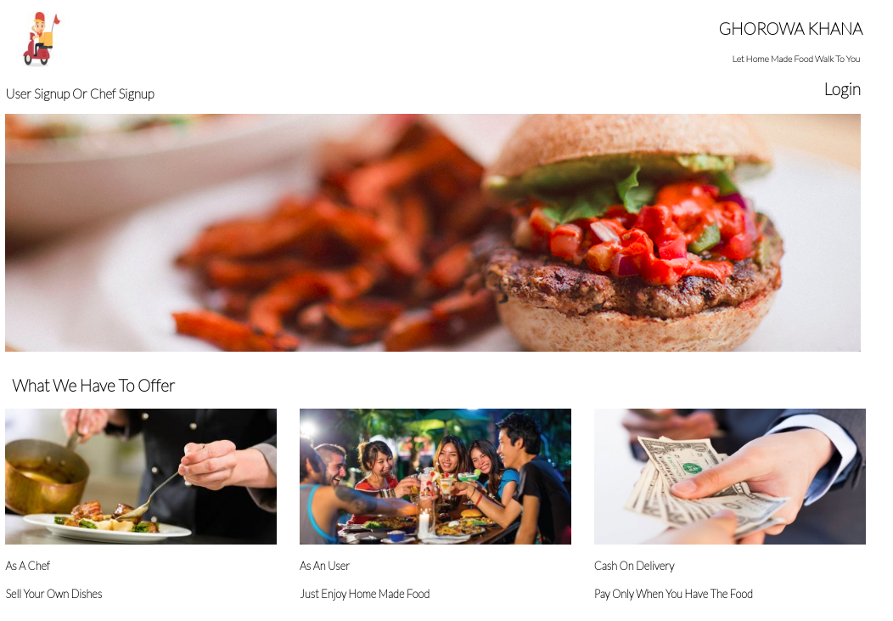

Slide 18
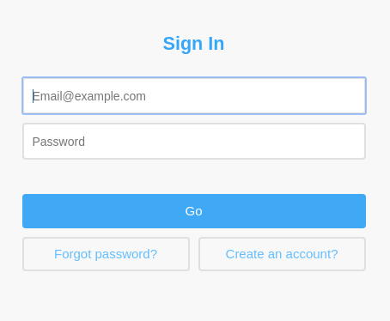

Slide 19
Thank you

